Slide 1
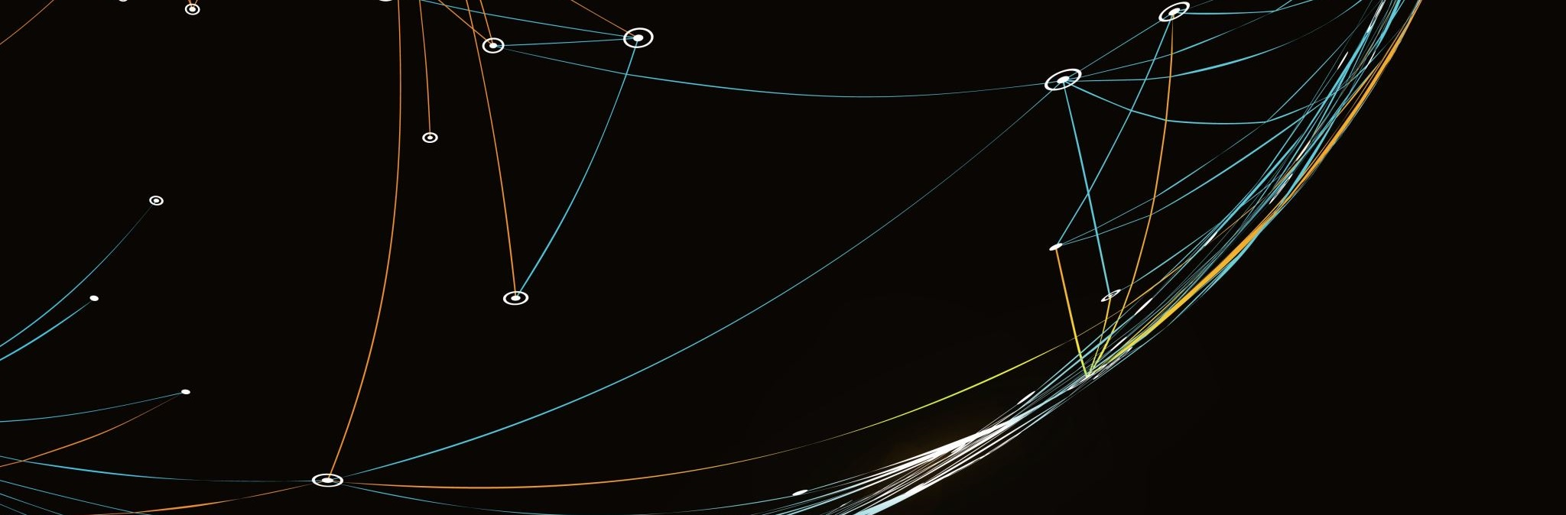
my passion - Tech
David Alex Čech

Slide 2
TECH – what i‘d like to talk about
HARDWARE
SOFTWARE
PHOTOGRAPHY
&

Slide 3
HARDWARE & SOFTWARE
when i was a child – old technology + brother
specs, performance
watching companies introducing stuff
reparing PCs
coding
piracy
trying all kinds of mods, apps, fiddling with settings

Slide 4
photographing
connecting hardware and software
learning to use aperature, shutter speed, iso
fiddling with settings
playing with post-processing afterwards
mainly nature, also people
but phones
would hate the work, just a hobby

Slide 5
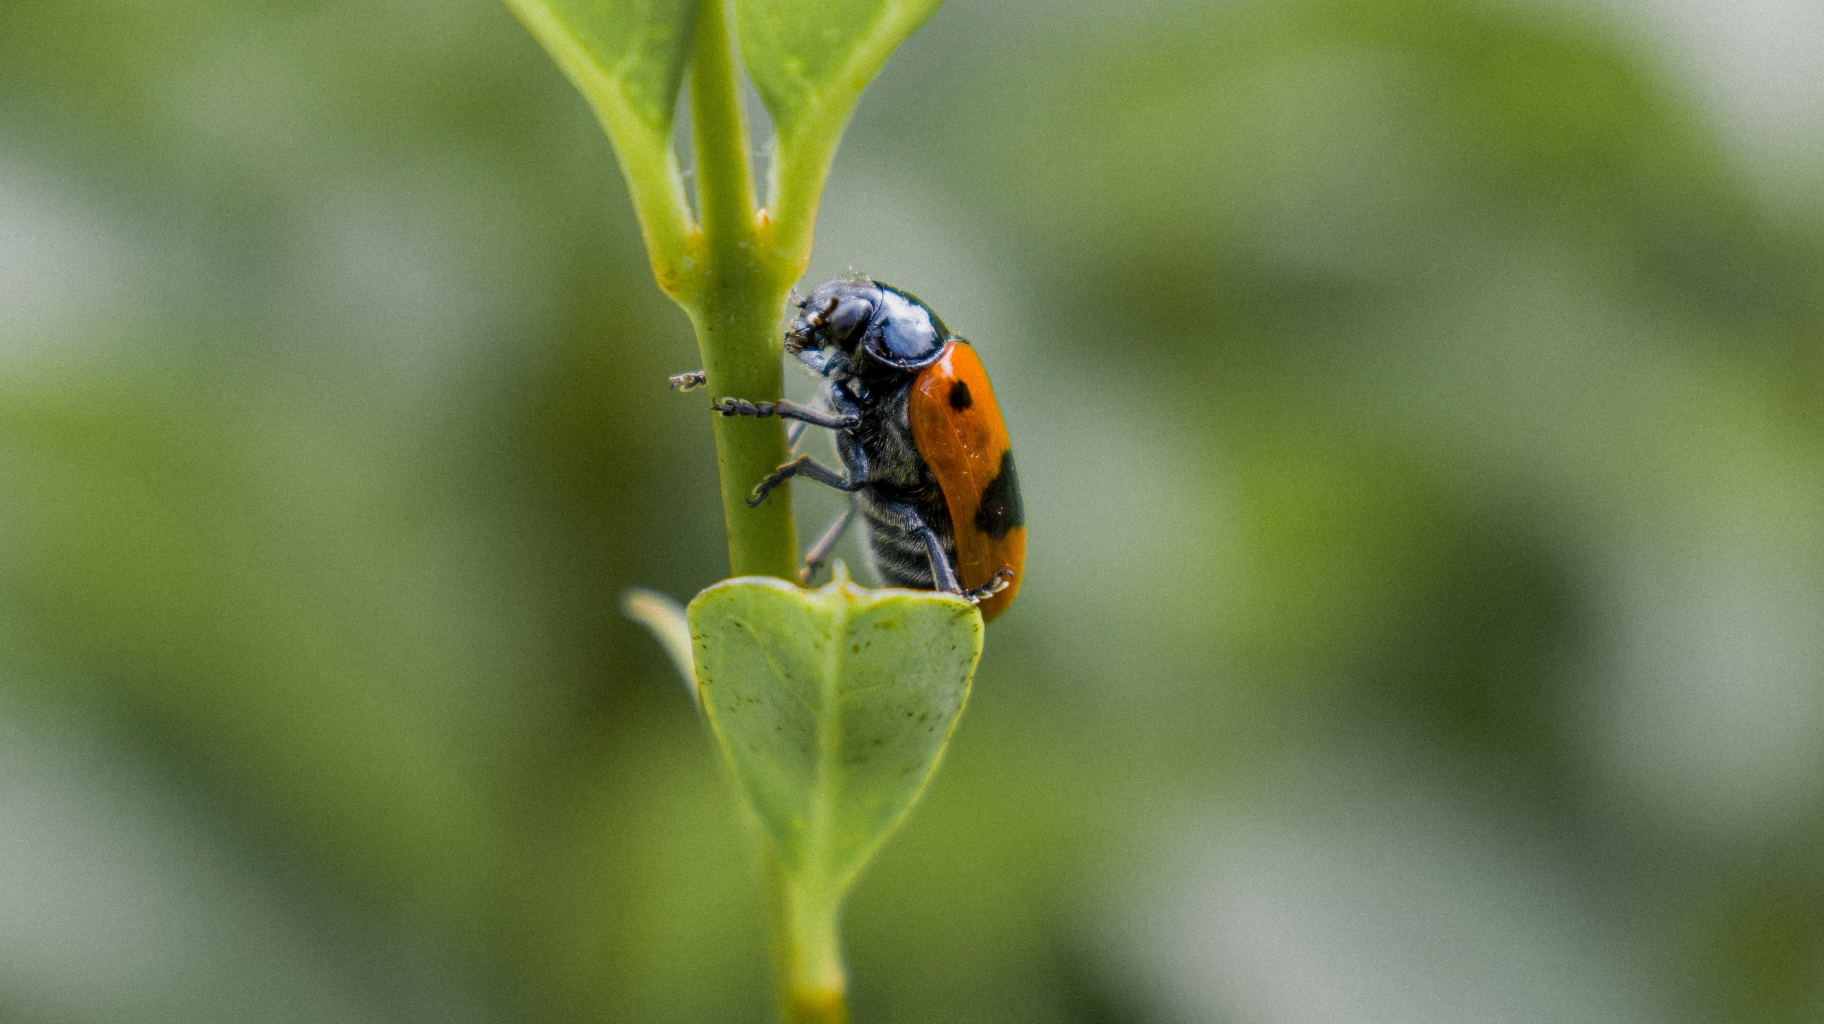
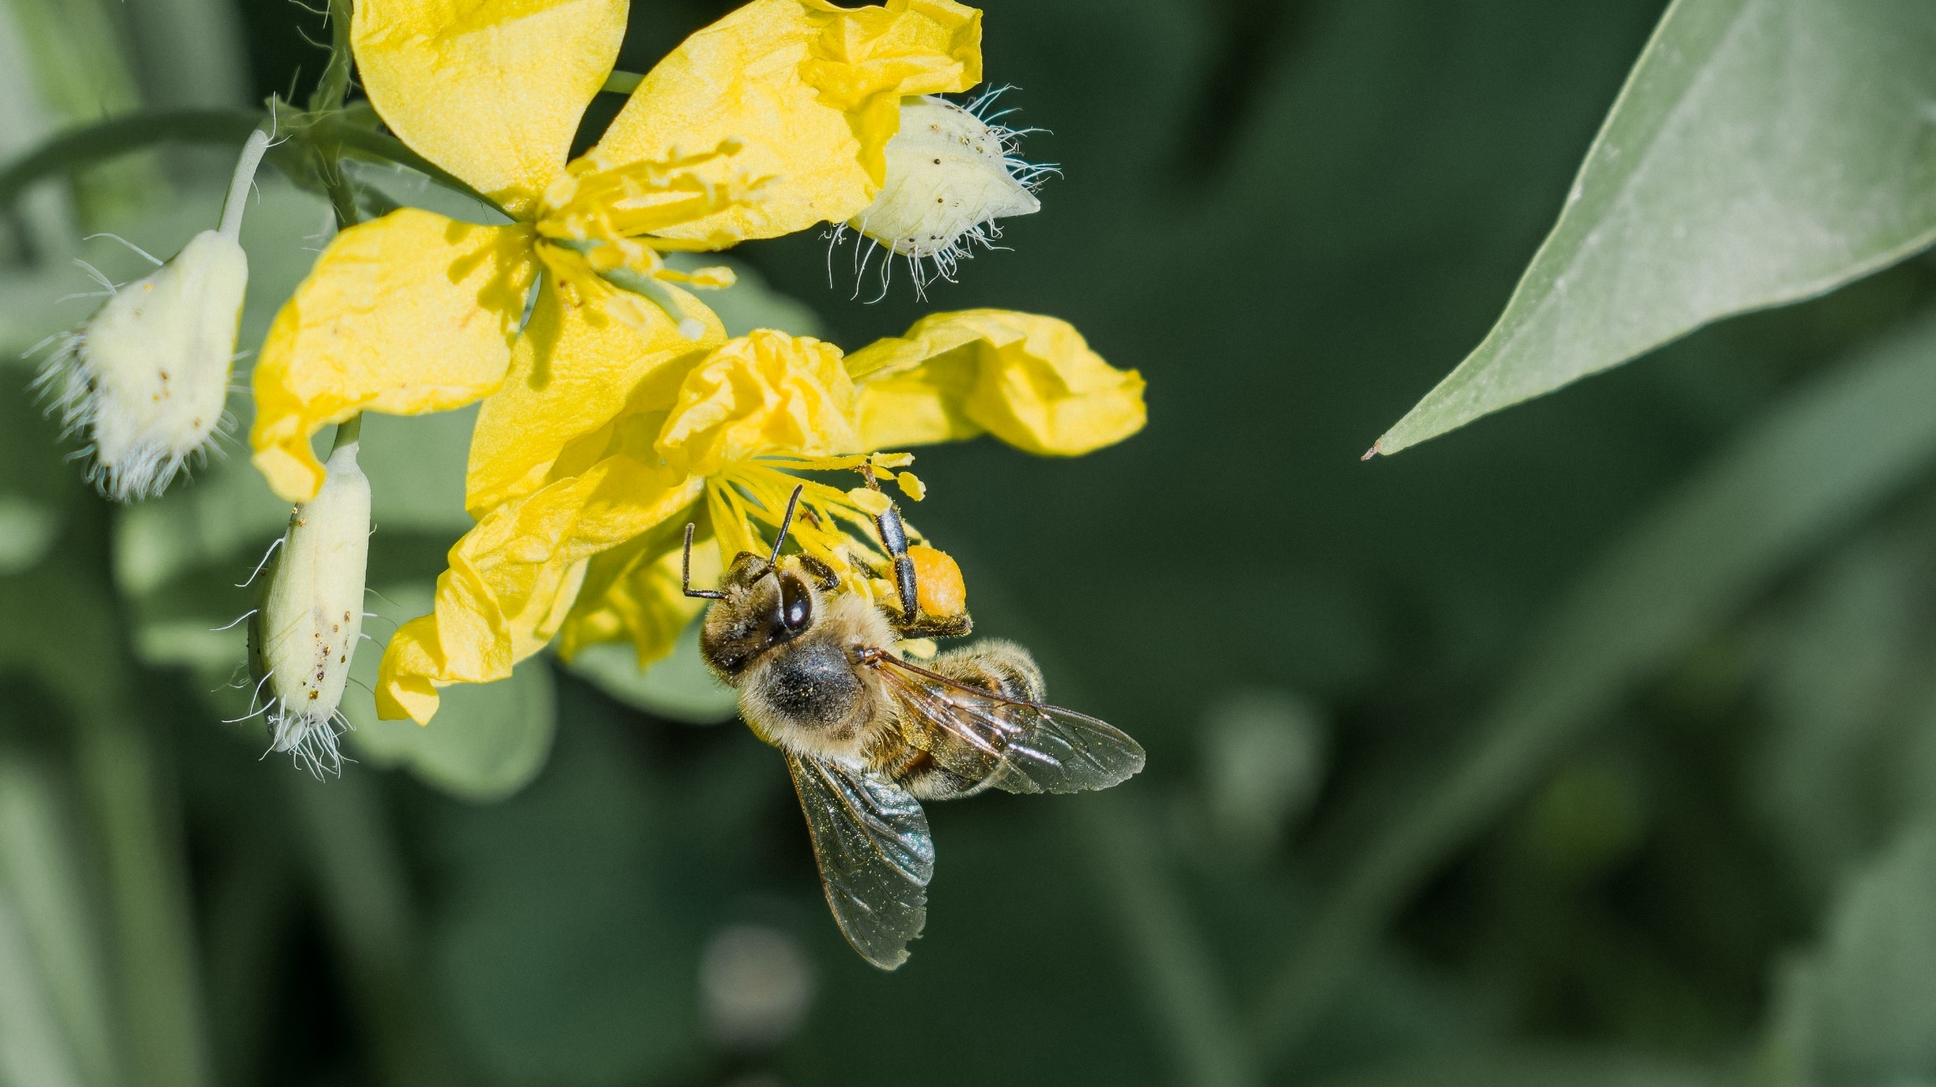
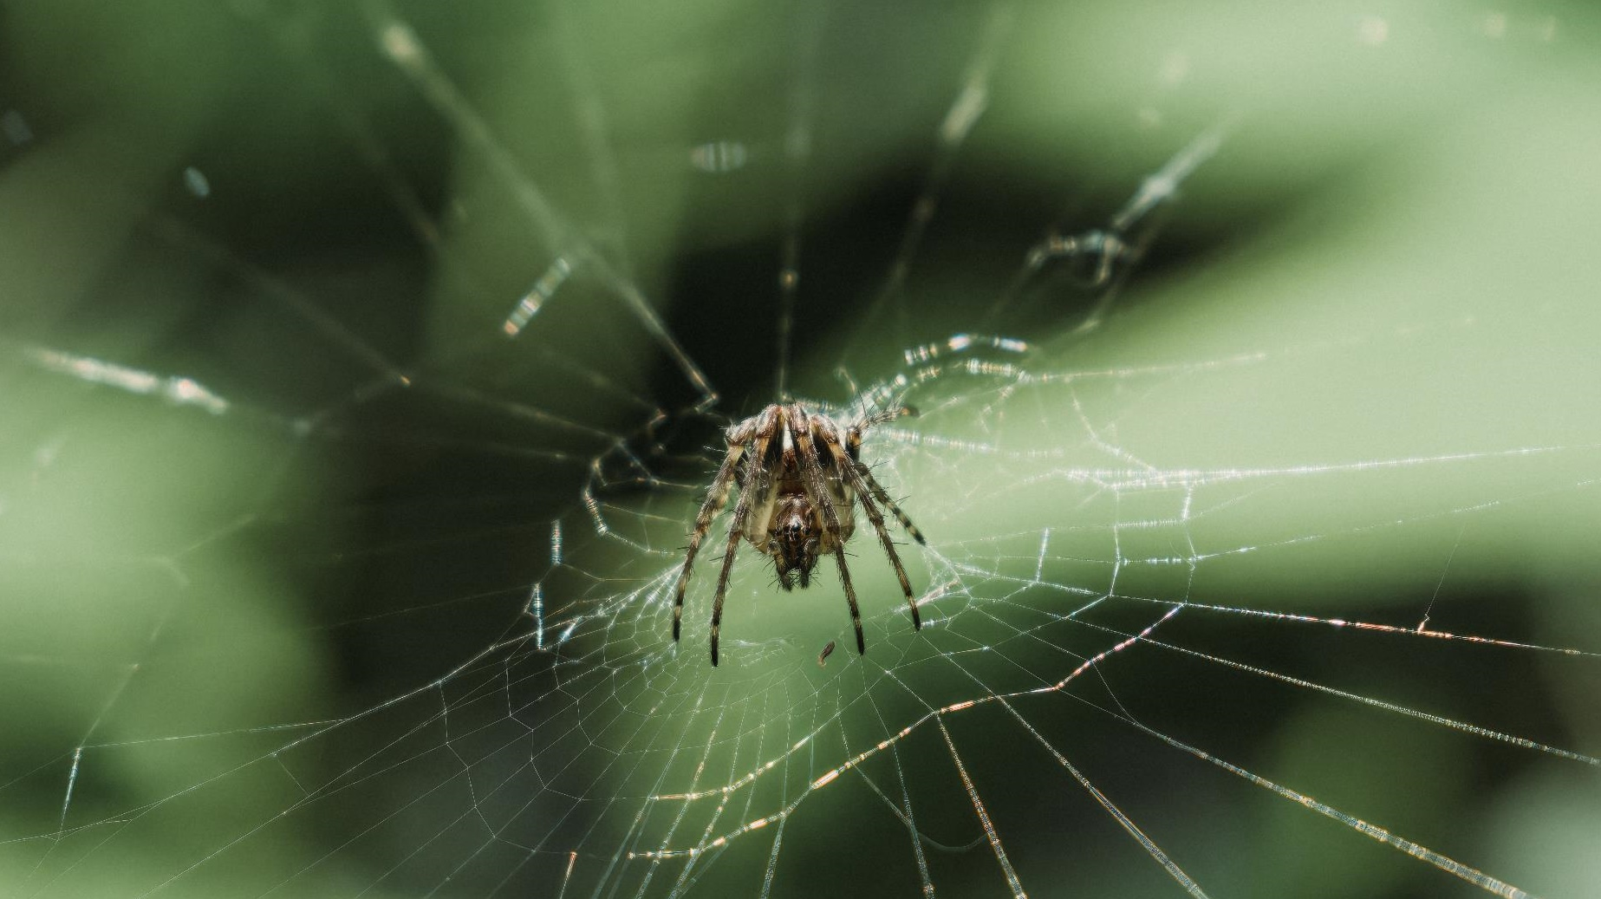
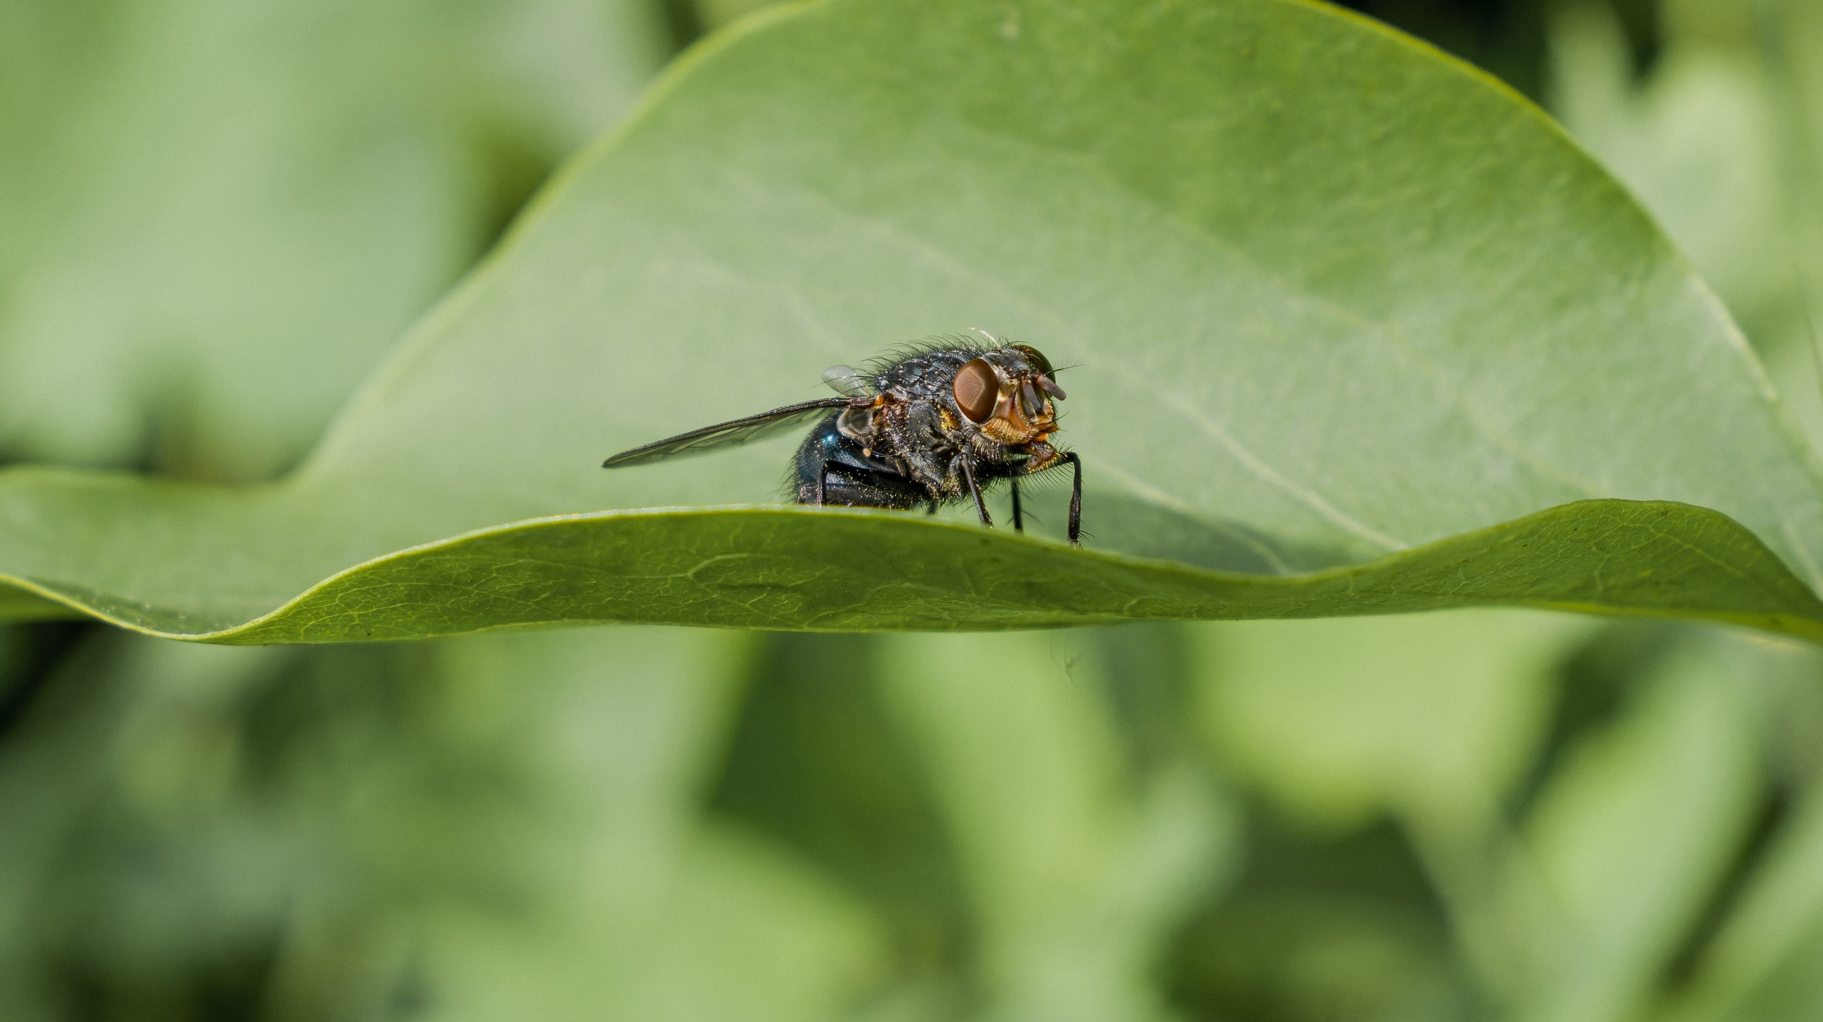

Slide 6
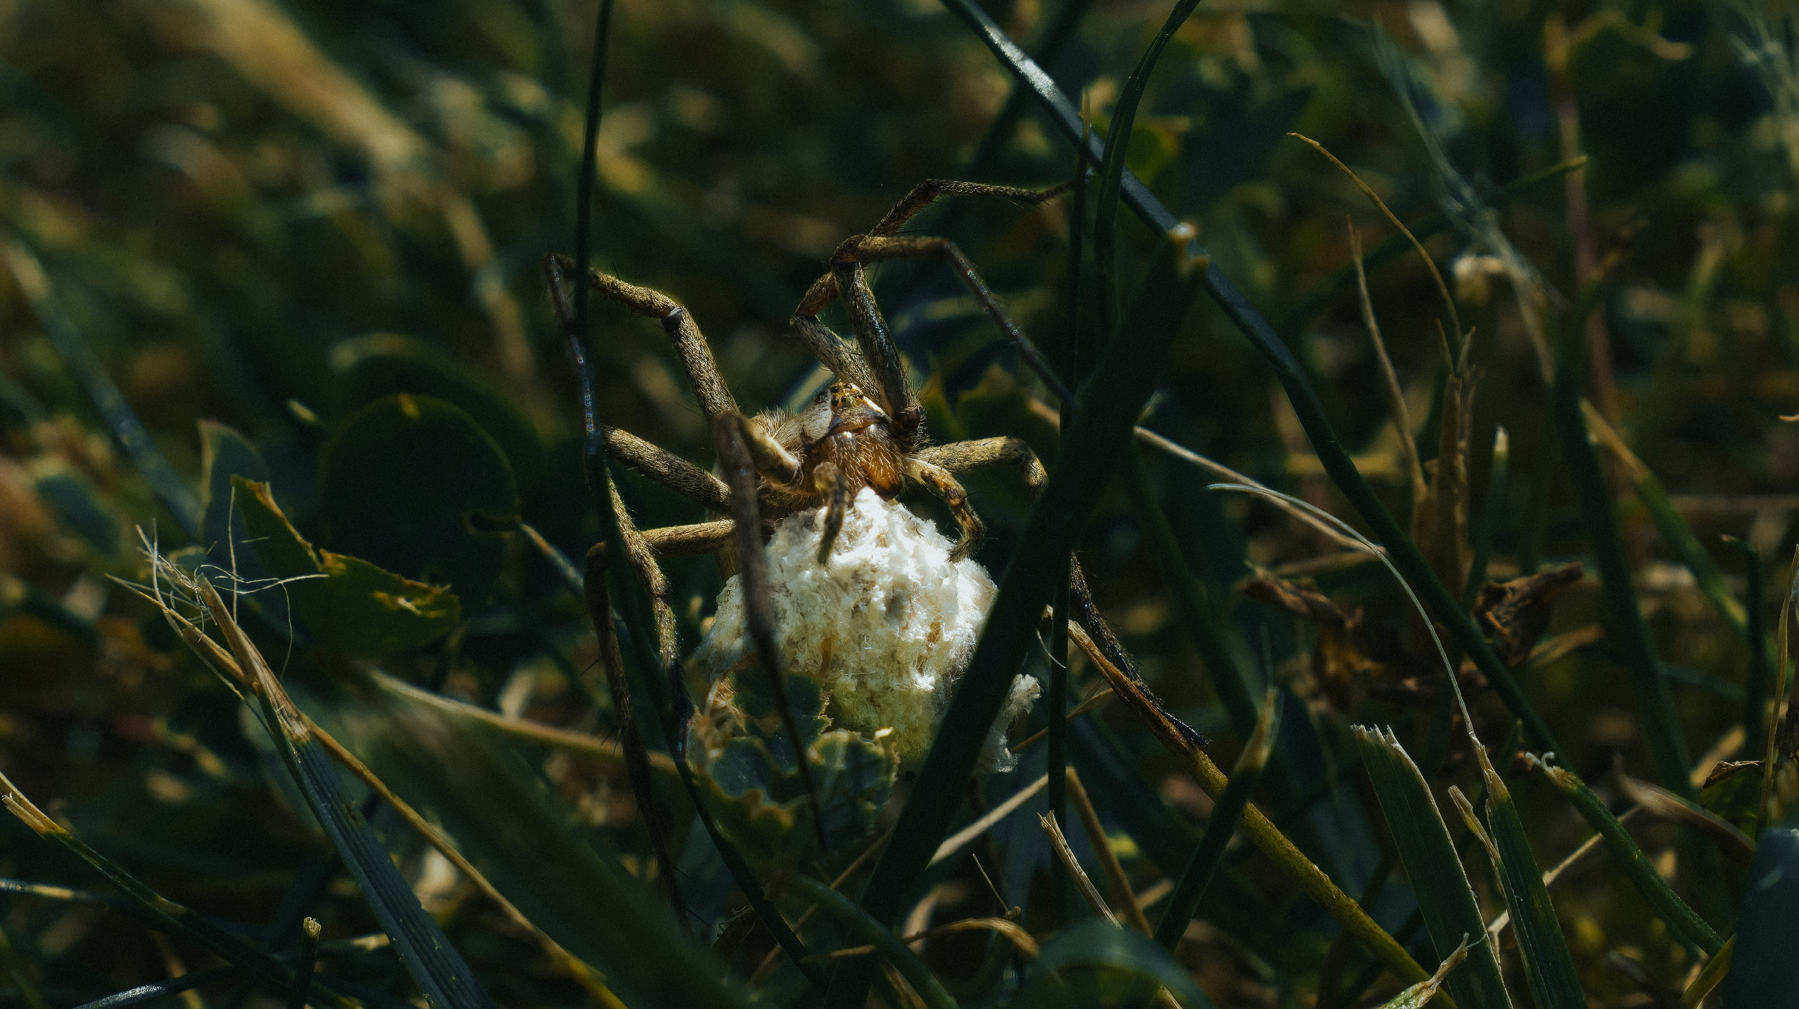
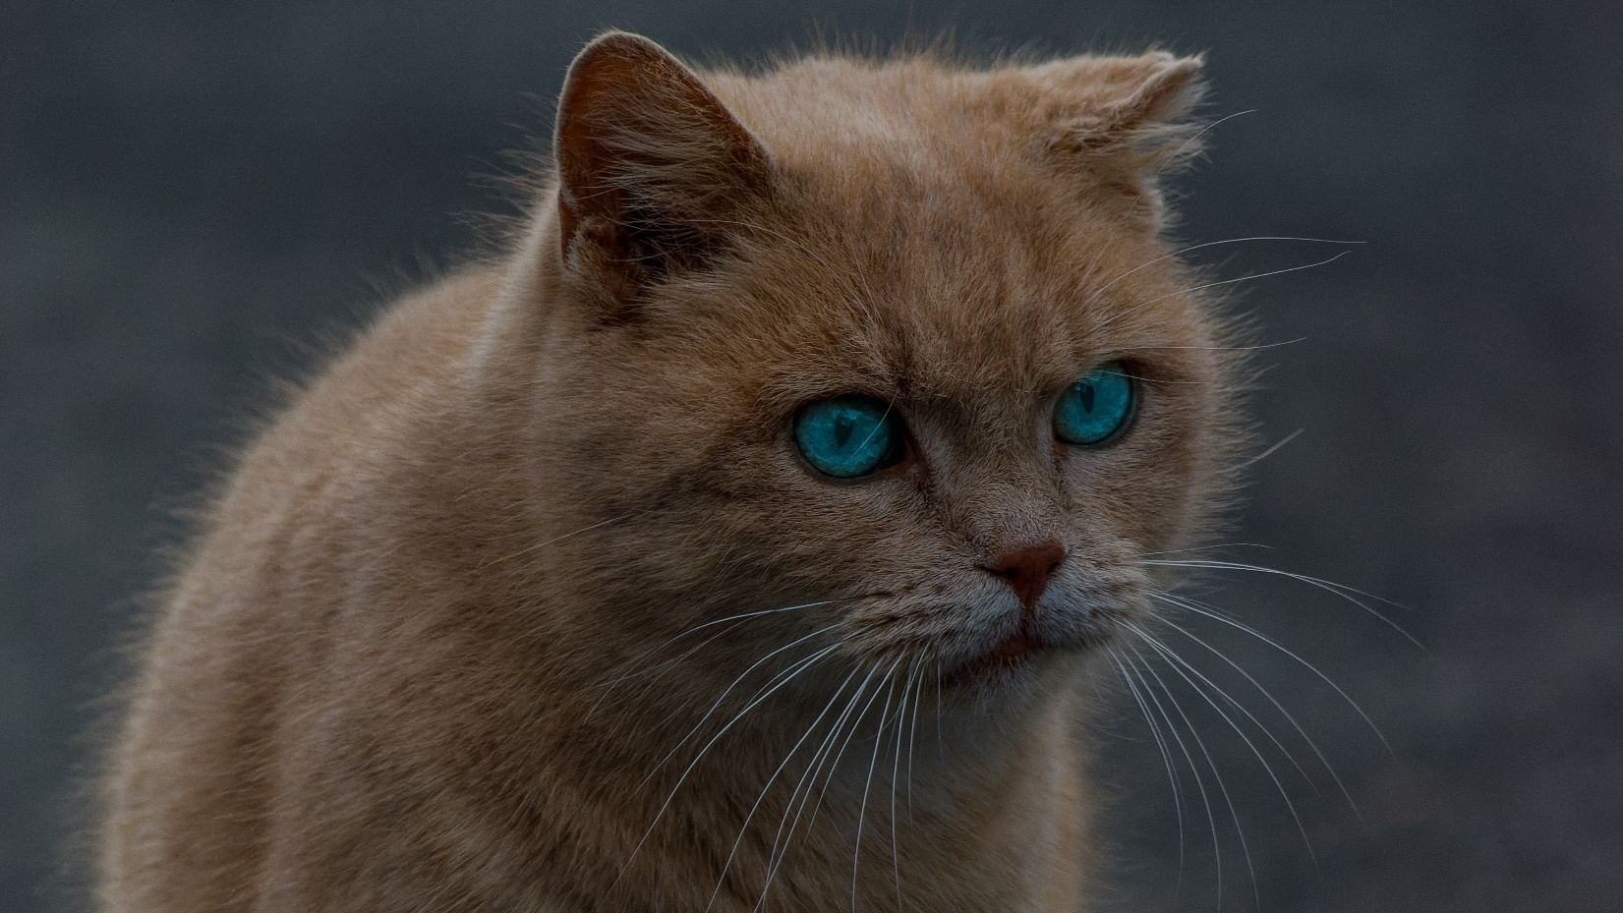
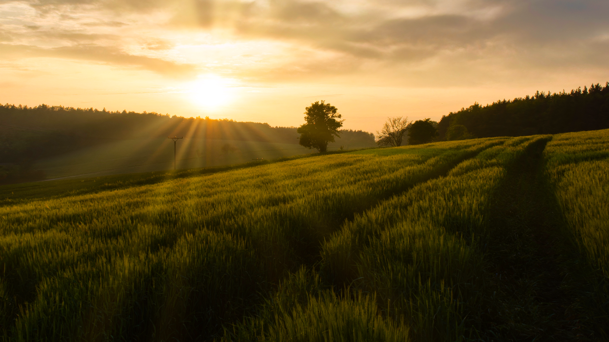
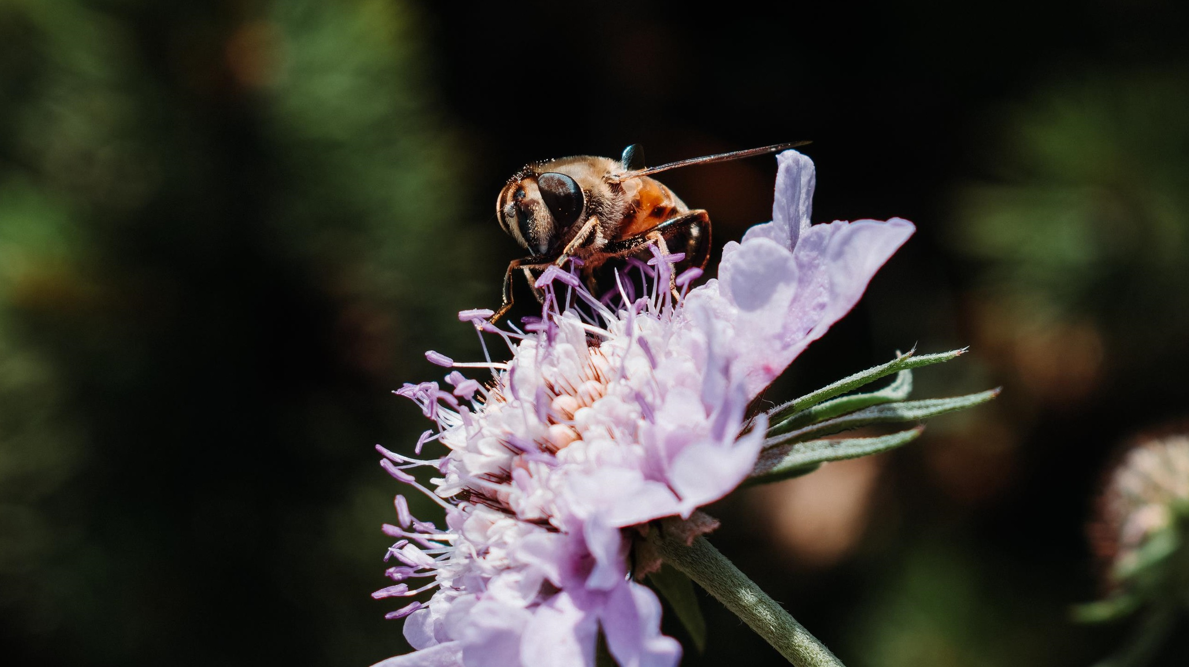

Slide 7
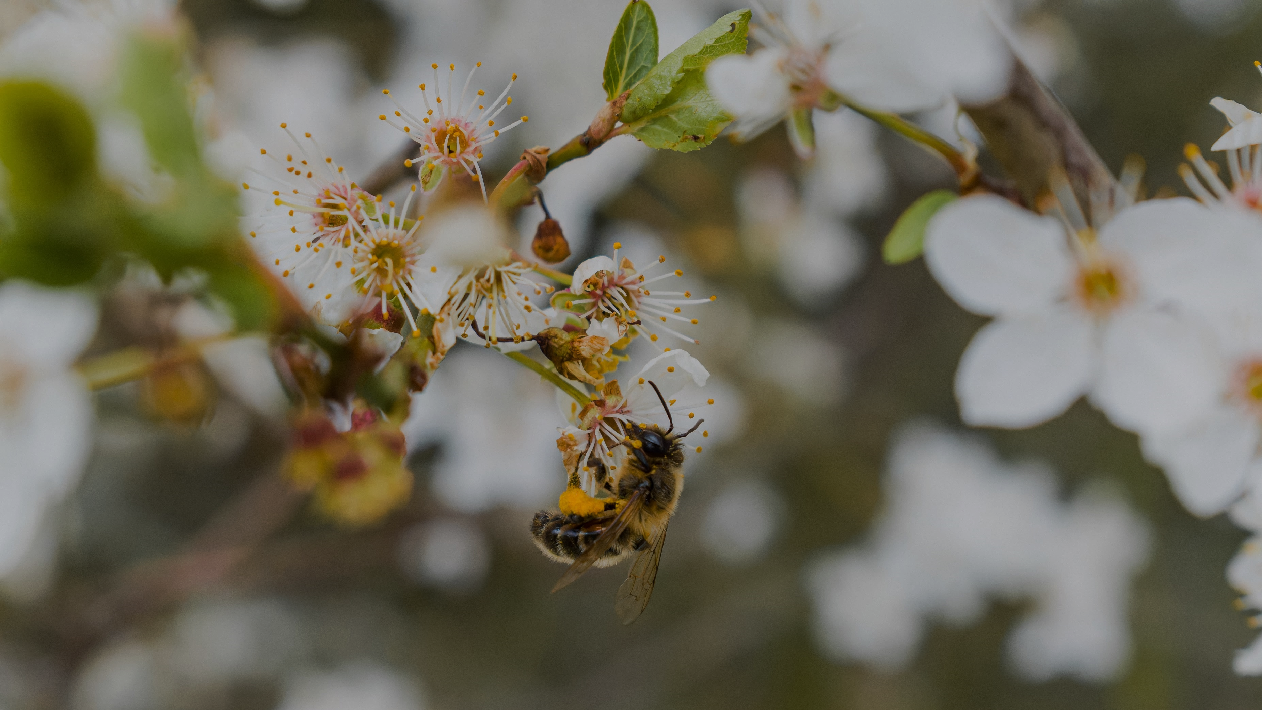
Thanks for your attention

